Slide 1
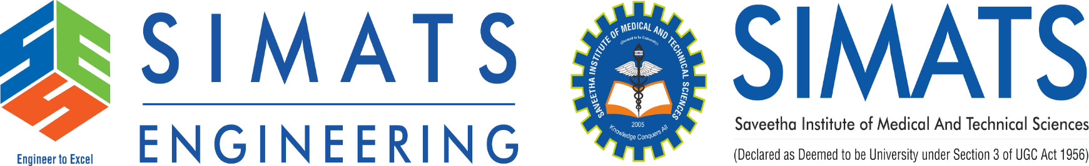
Cloud Storage Technologies
CSA1506- Cloud Computing and Big Data Analytics
Guided By
Dr. M. D. Boomija
Presented By
M. Pranay(19252382)

Slide 2


OBJECTIVES
Understand the concept of cloud storage.
Learn how cloud storage works.
Explore different cloud storage technologies.
Identify real-world applications.
Understand the benefits and challenges of cloud storage.

Slide 3
What is Cloud Storage?
Cloud Storage is a technology that stores digital data on remote servers connected through the Internet. Users can access their files anytime and from anywhere using computers or mobile devices.
Types of Cloud Storage
Object Storage – Stores files as objects (Amazon S3).
File Storage – Organizes data in folders and files.
Block Storage – Divides data into blocks for high-performance applications.

Slide 4
Key Features
Scalability
High Availability
Data Backup
Security and Encryption
Cost-Effective
Remote Access

Slide 5
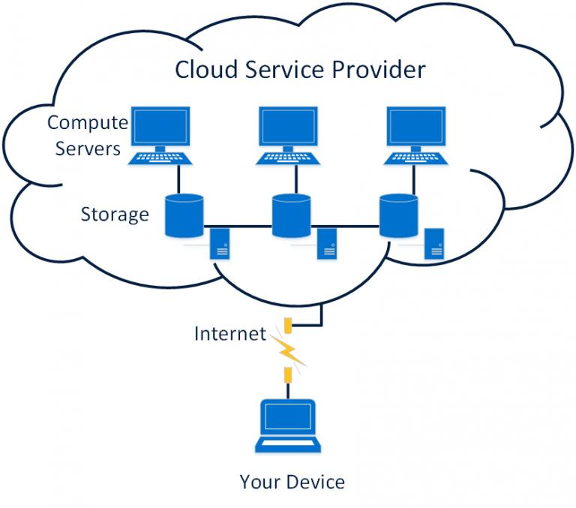
Architecture

Slide 6
Real-World Applications of Cloud Storage Technologies
Education
Google Drive for storing assignments.
Healthcare
Electronic Medical Records (EMR).
Business
Data backup and disaster recovery.
Banking
Secure customer data storage.
Entertainment
Netflix stores media content on cloud infrastructure.

Slide 7
Conclusion
Cloud Storage Technologies provide secure, scalable, and cost-effective solutions for storing digital data. They help individuals and organizations manage data efficiently while enabling access from anywhere.
Key Takeaways
Cloud storage stores data on remote servers.
Supports scalability and flexibility.
Provides backup and disaster recovery.
Used in education, healthcare, banking, and businesses.
Security and privacy are important considerations.

Slide 8
THANK YOU

